Slide 1
Where to post my stories
Dylan, Shaun, Gabrielle

Slide 2
To help redditors to post their story in the most recommended subreddit

Slide 3
Steps
Collection of data
Cleaning of data
Data preparation / Feature engineering
Modelling
Model Selection
Findings
Recommendation
Notes:
Data/feature engineering is the cleaning/tokenization of the words

Slide 4
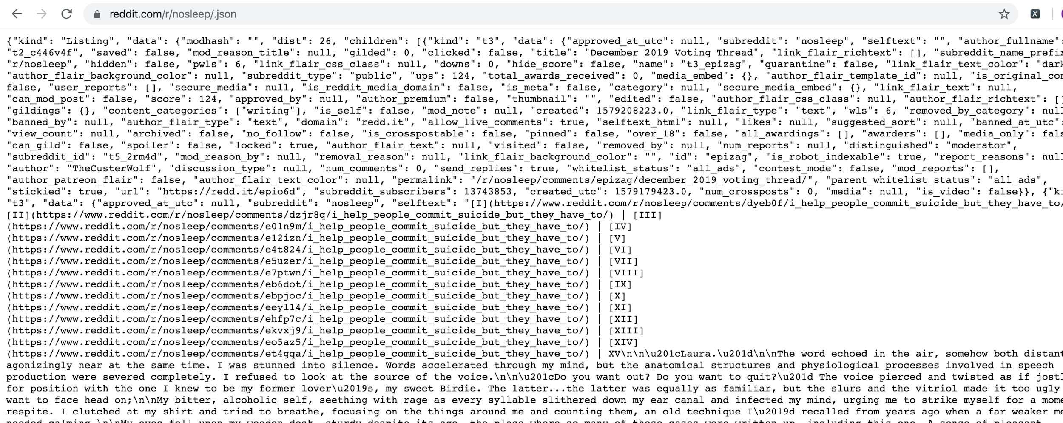
Collection of Data

Slide 5
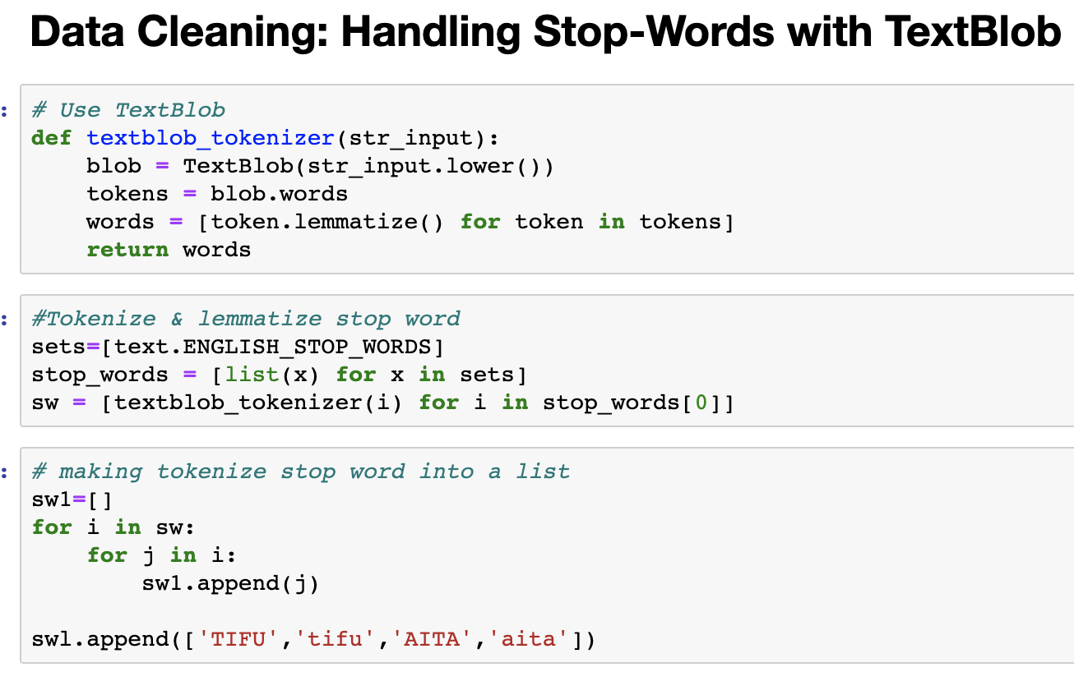
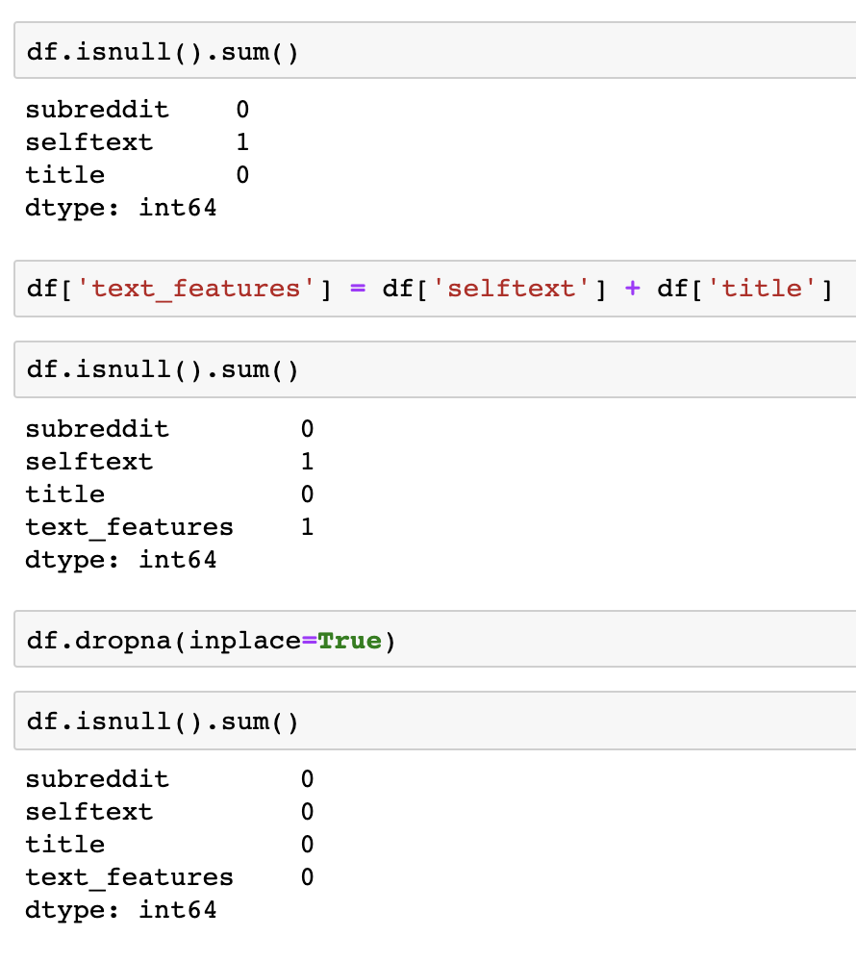
Cleaning of Data

Slide 6
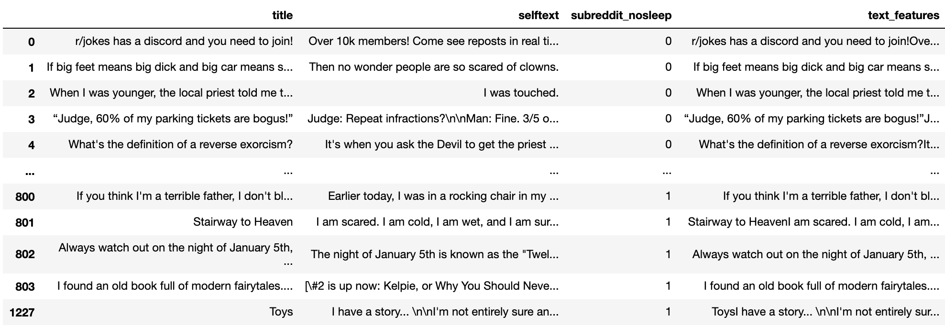
Data preparation / Feature engineering

Slide 7

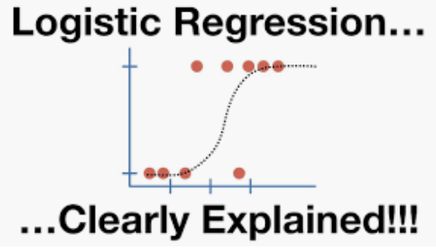

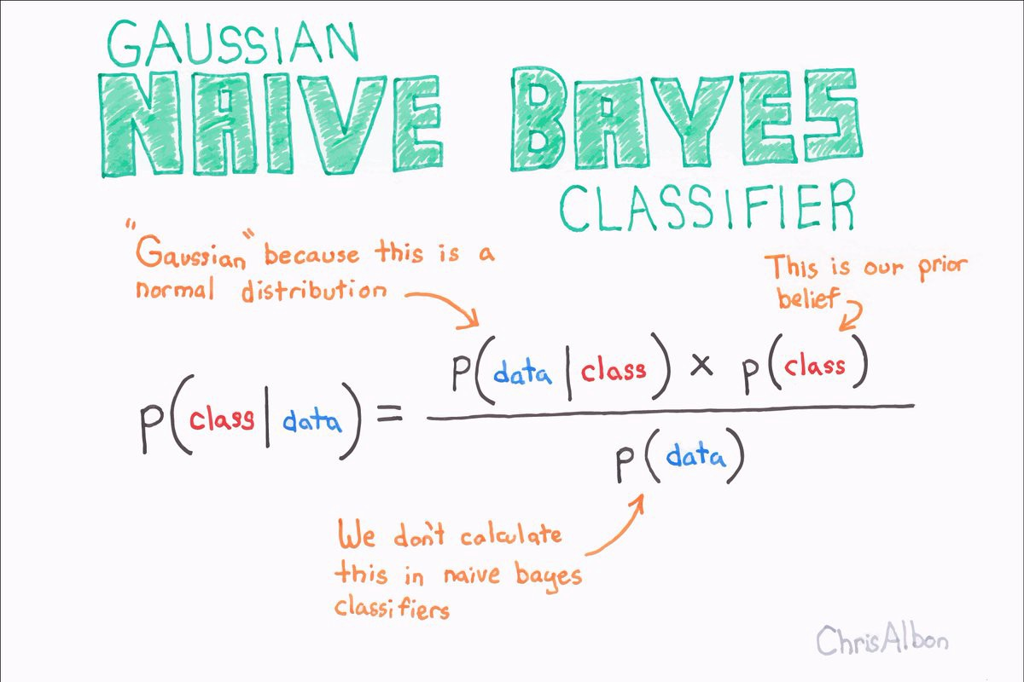
Modelling

Slide 8
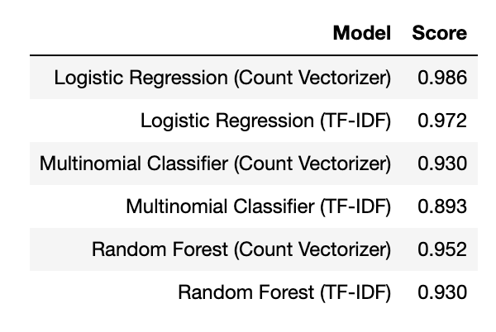
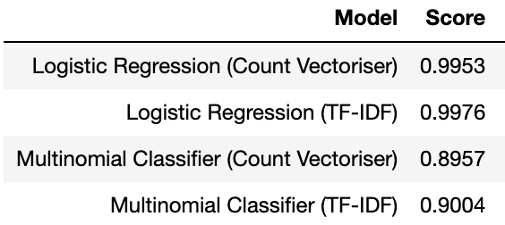
Model Selection
The effectiveness of the model will vary depending on the selected subreddit of interest
T.I.F.U & A.I.T.A
Jokes & No Sleep

Slide 9
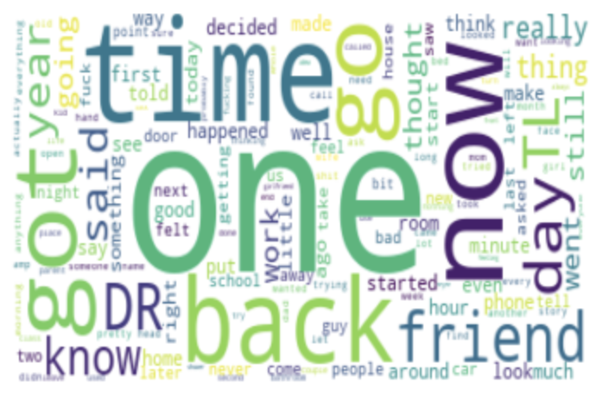
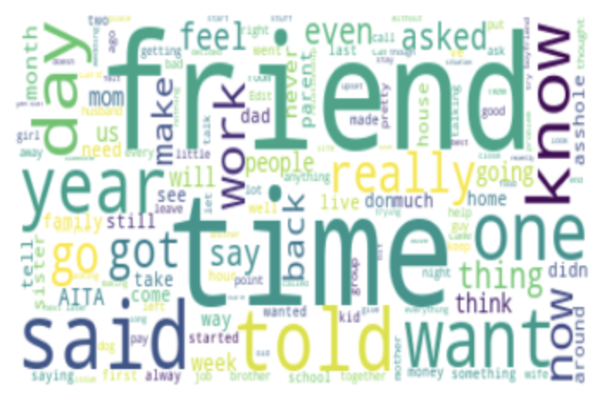
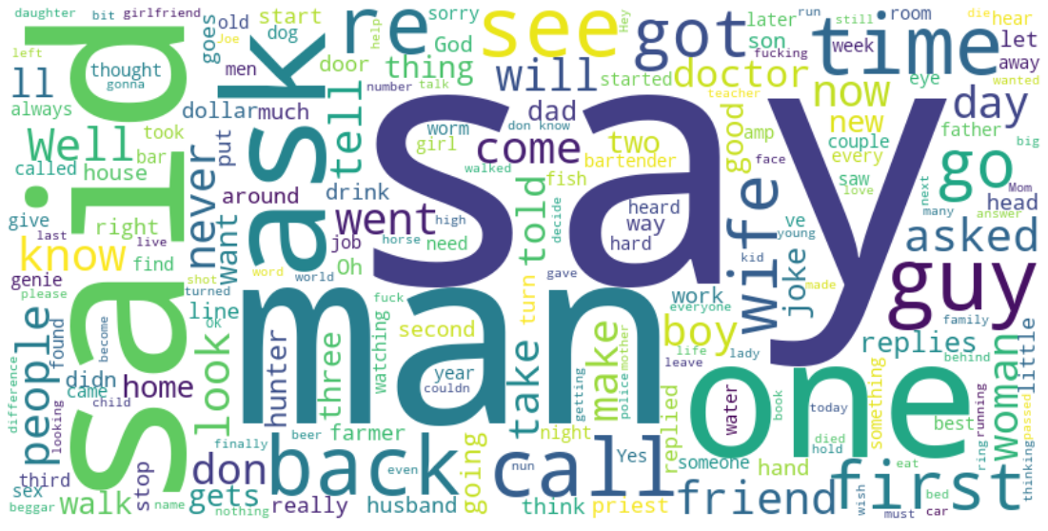
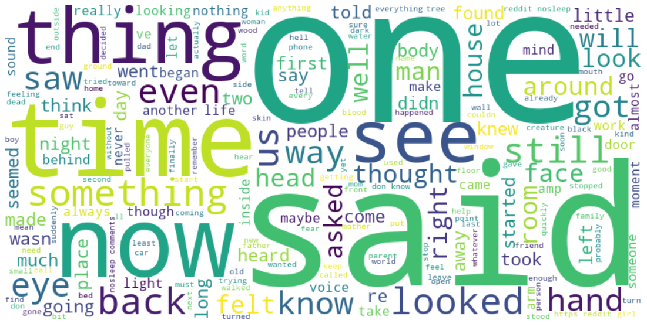
Initial hypothesis & Findings
T.I.F.U
A.I.T.A
Jokes
Nosleep

Slide 10
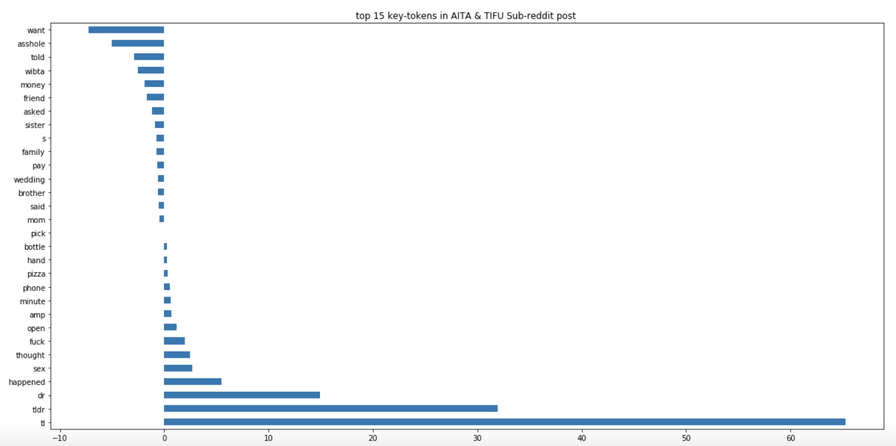
Initial Hypothesis & Findings
A.I.T.A
T.I.F.U

Slide 11
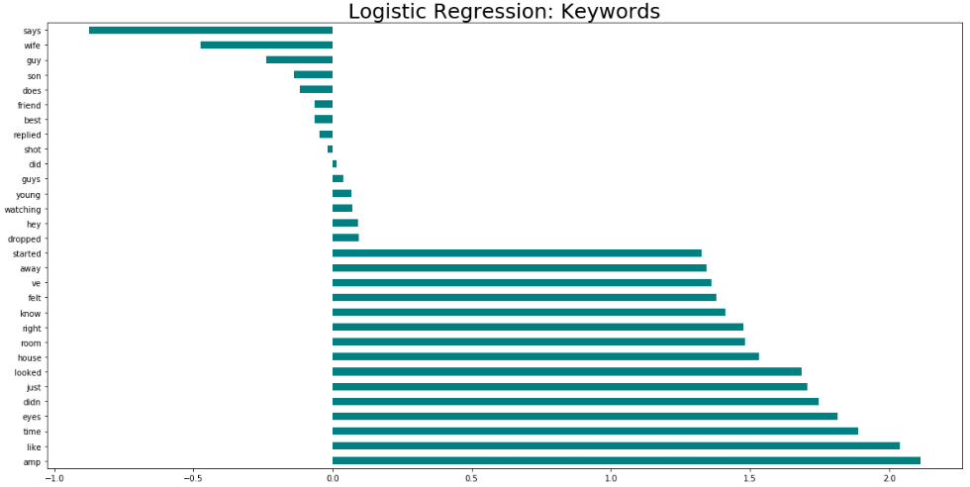
Initial Hypothesis & Findings
Jokes
Nosleep

Slide 12
Conclusions
It works.

